Slide 1

Ipl analysis
Analysis and Strategic Recommendations
-Visvasprabhakar R
Master In Business Analytics And Digital Marketing (MBE9)

Slide 2
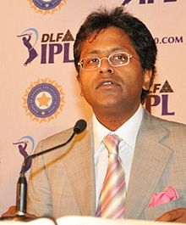
Overview
Launch Year: 2008
Founder: Board of Control for Cricket in India (BCCI)
Format: Twenty20 cricket (T20)
Teams: 8-10 franchises representing different cities in India
Duration: Typically runs for about two months (April-May)
Objective: To combine cricket and entertainment, attracting a
broad audience both in India and globally.
Lalit Modi, He was the founder, first chairman and League Commissioner of the Indian Premier League (IPL), and ran the tournament for three years until 2010.

Slide 3
Significance:
Global Reach: The IPL has become one of the most-watched sporting leagues in the world, with a significant international fanbase.
Economic Impact: The IPL contributes substantially to the Indian economy through sponsorships, advertisements, tourism, and media rights.
Cultural Influence: The league has popularized the T20 format and changed the way cricket is perceived, blending sports with entertainment.

Slide 4
Introduction to the STP Framework:
Segmentation (S): Dividing a market into distinct groups based on similar characteristics. It allows marketers to identify and understand different consumer needs.
Targeting (T): Selecting specific segments to focus marketing efforts on. It involves choosing the most attractive segment(s) to serve.
Positioning (P): Establishing a unique image or identity for a product in the consumers' minds. It defines how the product is perceived relative to competitors.
Targeting
Positioning
Segmentation

Slide 5

Market Segmentation in the Indian Premier League (IPL)
Overview of Segmentation:
Demographic Segmentation: Dividing the audience based on age, gender, location, income, etc.
Psychographic Segmentation: Based on lifestyle, interests, and values.
Behavioral Segmentation: Focus on audience behavior like viewing habits, loyalty, and engagement.

Slide 6
Key Segments Identified in IPL:
Data for Circular Diagram:
Demographics:
Age Groups: 15-25 (40%), 26-35 (30%), 36-45 (20%), 46+ (10%)
Gender: Male (70%), Female (30%)
Location: Urban (65%), Semi-Urban (25%), Rural (10%)
Psychographics:
Interests: Sports Enthusiasts (60%), Casual Viewers (30%), Non-Cricket Viewers (10%)
Behavior:
Watching Mode: TV (50%), Mobile (30%), In-Stadium (15%), Other (5%)

Slide 7
Targeting Strategy in IPL
Key Target Segments:
Urban Youth (15-35 years): Core target audience, with a focus on those who engage actively with sports and entertainment.
Regional Fan Bases:
Targeting fans based on the geographic location of teams (e.g., Chennai Super Kings fans in Tamil Nadu).
Corporate Sponsors & Advertisers:
Companies seeking visibility through IPL's wide reach.
Key Target Segments:
Urban Youth (15-35 years): Core target audience, with a focus on those who engage actively with sports and entertainment.
Cricket Enthusiasts: Individuals who follow the sport closely, including international fans.

Slide 8

Targeting Strategy:
Custom Content: Tailored marketing campaigns to appeal to different target groups, such as social media engagement for urban youth.
Regional Promotions: Localized marketing efforts in cities/states with strong regional team support.
International Outreach: Engaging international cricket fans through broadcasting and digital platforms.
Sponsorship Opportunities: Attracting corporate sponsors with targeted advertising packages.

Slide 9
Positioning Strategy in IPL
Overview of Positioning:
Definition: Positioning is the process of establishing a brand or product's unique place in the minds of the target audience. It differentiates the brand from its competitors by highlighting its unique value proposition.
2. IPL’s Positioning Strategy:
Premium Sports-Entertainment Hybrid: IPL is positioned not just as a cricket league but as a high-energy entertainment event that blends sports with glamour, music, and celebrity culture.
Cricketainment: The concept of "Cricketainment" merges the thrill of T20 cricket with entertainment elements, appealing to both hardcore cricket fans and casual viewers looking for an engaging experience.

Slide 10
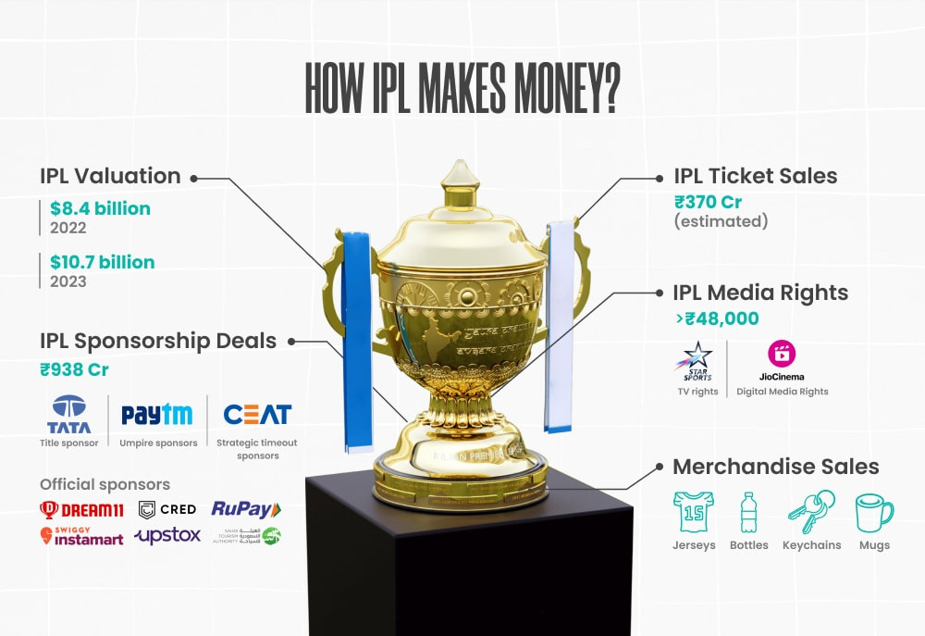
Association with Celebrities: IPL leverages Bollywood stars, music performances, and other entertainment elements to create a unique identity that appeals to a wide audience.
Global Appeal: Though primarily focused on the Indian market, IPL’s positioning as a world-class event with international players and global fan engagement helps it stand out on the global stage.
Regional Loyalty: Positioning each franchise as a regional pride, tapping into local fanbases and fostering a strong connection with cities and states.

Slide 11
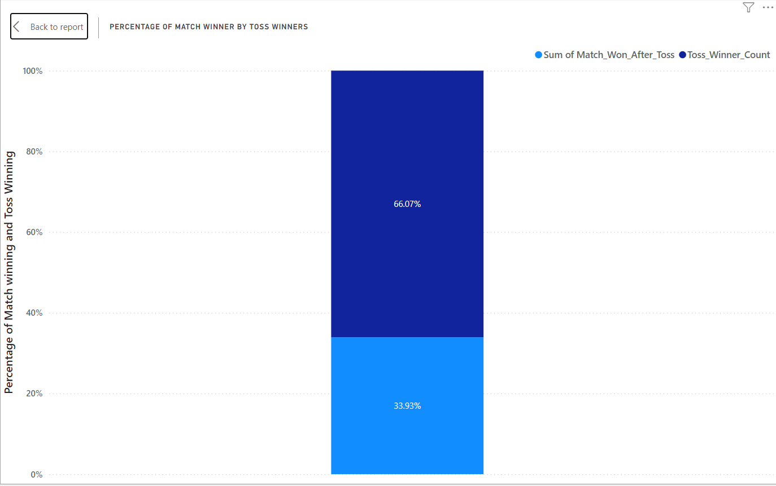
Percentage of Match winner By toss Winners
In the first insight, we will calculate the percentage of match wins by toss winners. We will use formulas to determine the number of times the toss winner also won the match and the total number of toss wins.
Formula Used:
Match_Won_After_Toss = IF([toss_winner] = [winner], 1, 0)
Toss_Winner_Count = COUNT('matches (1)'[toss_winner])

Slide 12
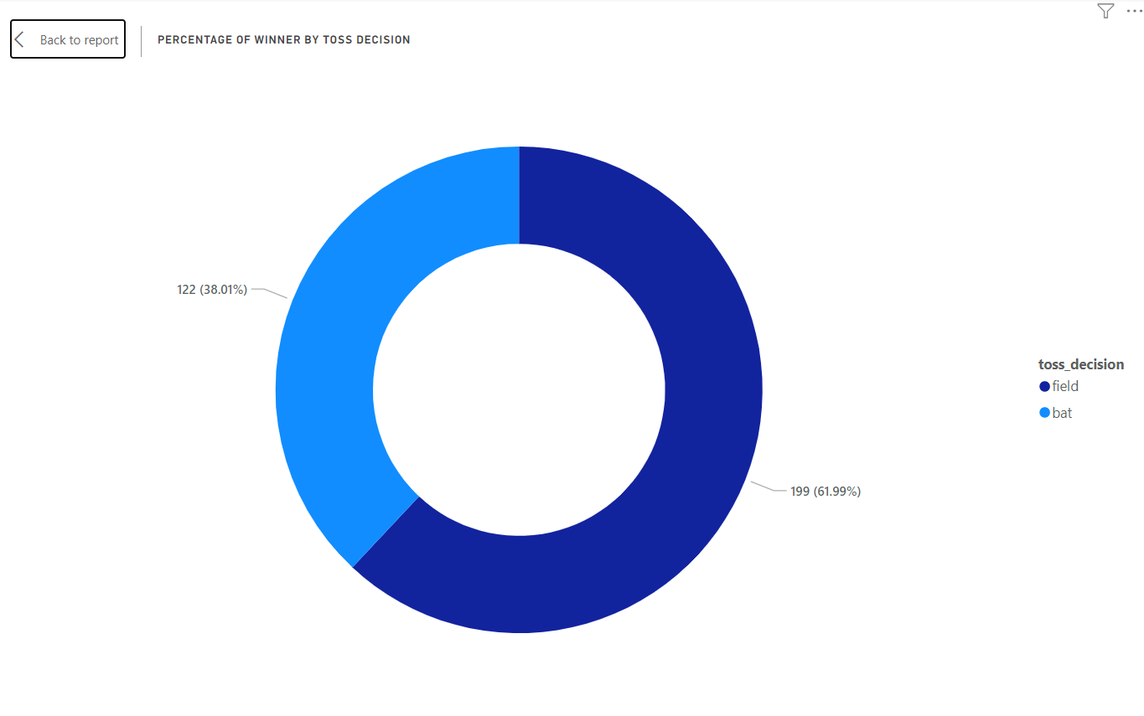
Percentage of Winner by Toss Decision
In this analysis, we will calculate the percentage of match wins based on the toss decision. We'll focus on the columns Toss Winner, Toss Decision, and the number of matches won after the toss. This will help us identify which toss decision is most strongly associated with a higher winning percentage.

Slide 13
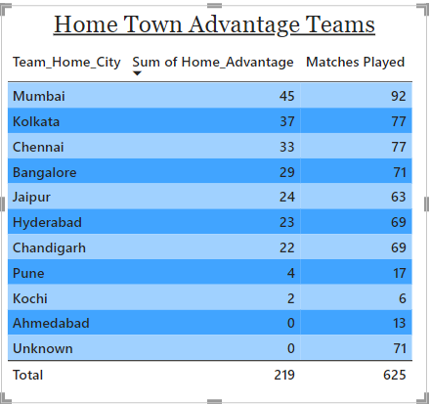
Home Town Advantage Teams
In this analysis, we will identify teams with a home-town advantage. We will use the 'Match ID' column to determine the number of matches played. Next, we'll map each team to their respective home city, indicating which team played on their home ground. Finally, we'll calculate the sum of matches won at home to identify the total home-town advantage for each team.

Slide 14
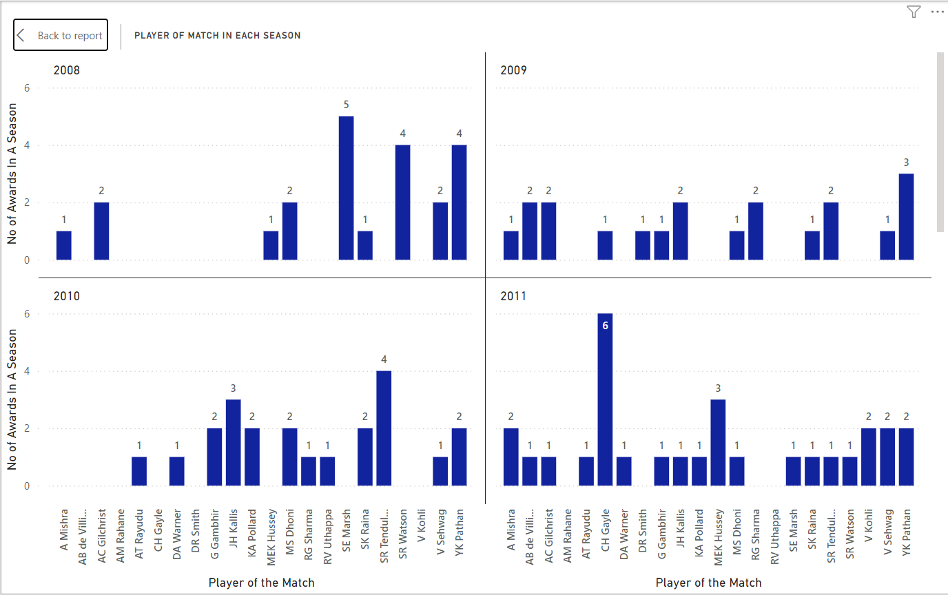
Player of Match in Each Season
In this analysis, we will focus on the players who received the "Player of the Season" award. We will examine the columns for "Player of the Season," the number of matches they played, and the season. This will help us understand how certain players consistently received the "Player of the Season" award from 2008 onwards, with the only difference being the number of times they were awarded.

Slide 15
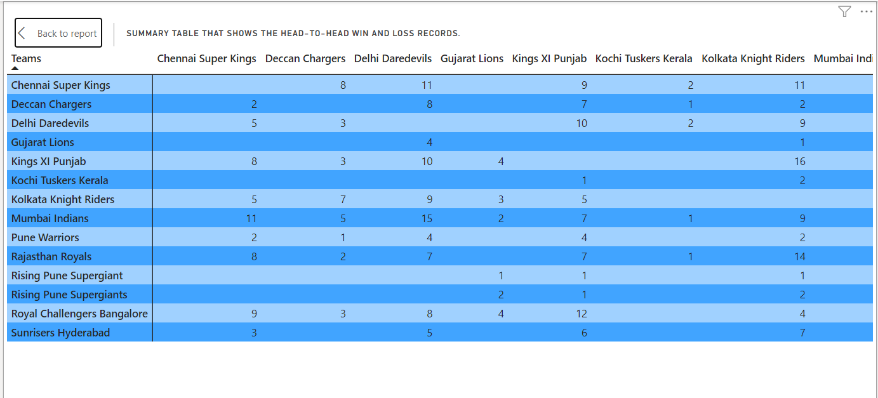
Head to Head Analysis
In this insight, we will analyze head-to-head performance, focusing on how one team dominantly performs against each of their opponent teams. Some teams consistently struggle against the same opponents, while others are strong enough to maintain an equal record in head-to-head matchups.

Slide 16
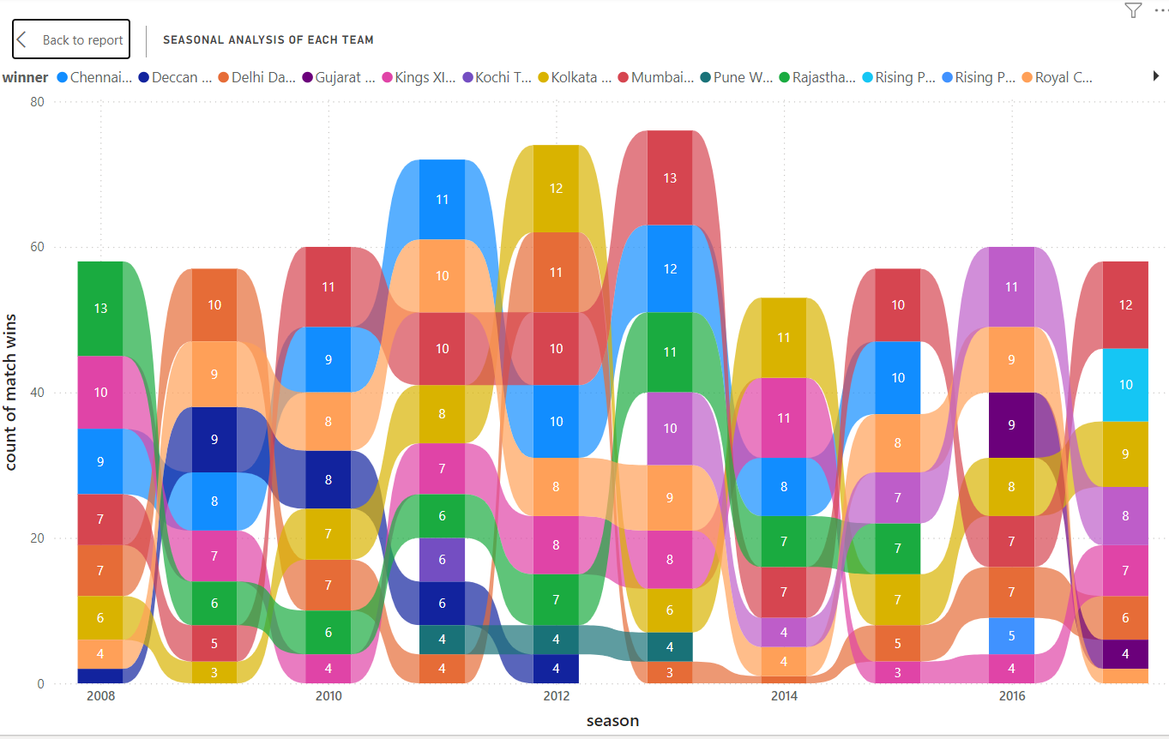
Seasonal Analysis
In this analysis, we will examine the seasonal performance of each team, ranking them by season over time. We will include a time series comparison, allowing for the selection of two specific teams through filters to compare their performance across all seasons. This will help identify how some teams have dominantly performed in recent seasons.

Slide 17
Batsman Analysis
In this analysis, we will evaluate batsmen based on their runs, strike rate, fours, and sixes. We will categorize the batsmen according to their strike rate into three groups: elite strikers, effective strikers, and anchor role T20 batsmen. Additionally, we will identify the top 50 players with the highest boundary scores. This analysis will help us assess individual performance within the team, determine which players are best suited for different batting orders, and provide insights into their overall effectiveness.

Slide 18
Bowler Analysis
In this analysis, we will focus on evaluating bowlers based on the highest number of wickets taken, particularly examining specific bowler-batsman matchups. We will identify the top 30 bowlers who have efficiently dismissed the most top-order batsmen. By doing so, we can prepare for the upcoming season, as top-order batsmen are crucial in T20s. This analysis will help us assess the individual performance of bowlers and determine which bowler is best suited to bowl against specific batsmen

Slide 19
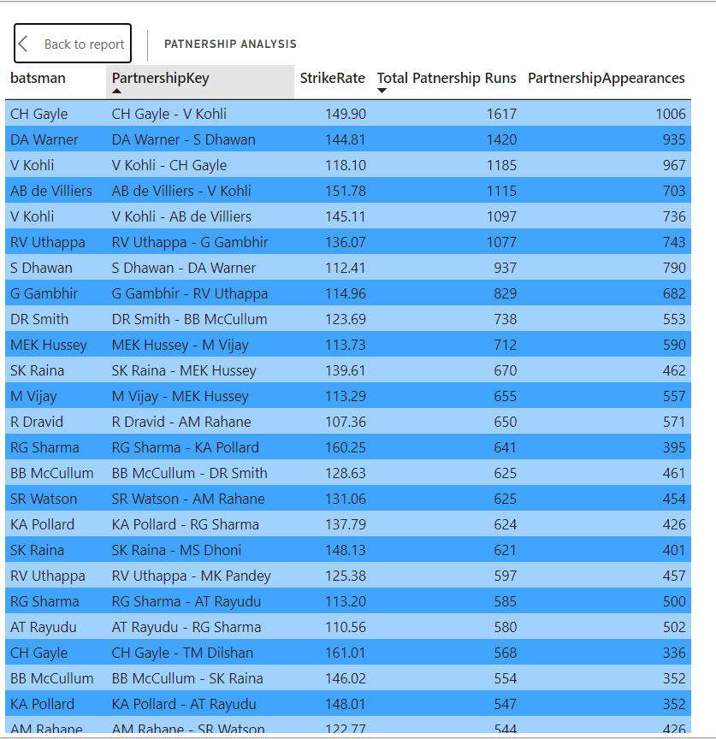
Partnership Analysis
In this analysis, we will examine partnership performance by focusing on the following aspects: the batsmen involved, their partnership key, the total partnership score across all seasons, their strike rates, and the number of matches in which their partnership has contributed more than 50 runs. This analysis will help us determine which pair of batsmen has been most effective for the team, assess the strength of their strike rates, and understand how their partnership contributes crucial runs in each match. Therefore, partnership analysis is an essential aspect of evaluating team performance.

Slide 20
Clutch Analysis
In this analysis, we will focus on clutch situations in cricket. Clutch situations often arise when a team must be prepared to perform under pressure. We will analyze the runs conceded during powerplay, middle overs, and death overs, as well as the wickets taken during the powerplay by each team. Additionally, we will identify bowlers who have conceded the most runs in death overs and evaluate the strike rates of batsmen in clutch situations. This will help us strategize bowling plans and identify areas for improving bowling performance.

Slide 21
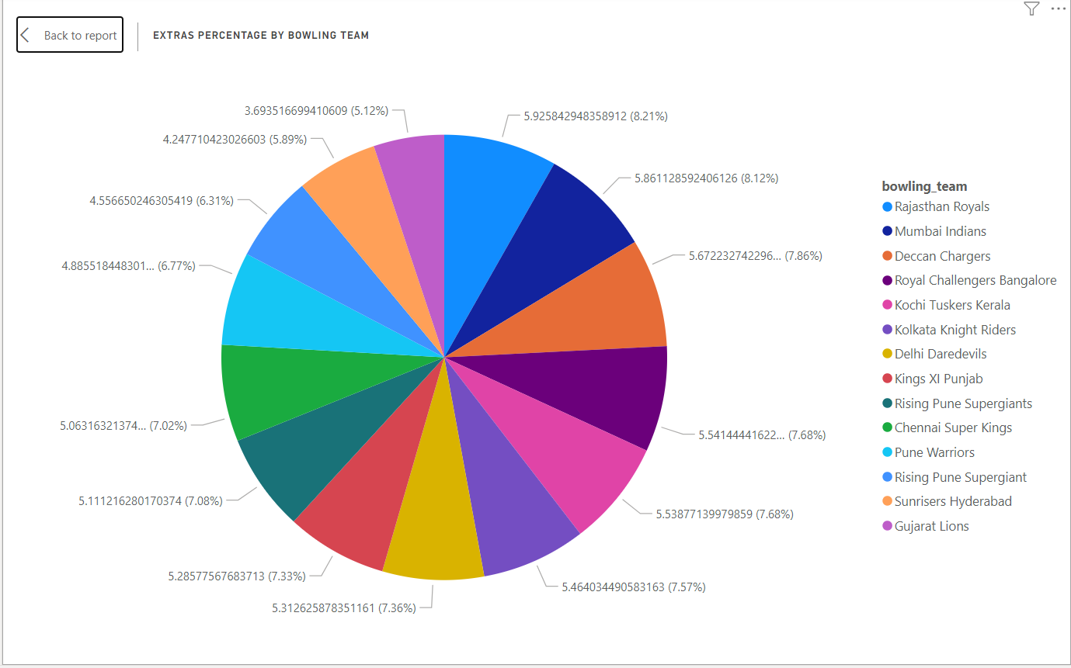
Extras Runs Percentage by bowling team
In this analysis, we will examine the extra runs conceded by each team to determine if any team has conceded a significant number of extra runs. If so, the team can analyze these instances to find ways to minimize them.

Slide 22
Analysis Reports:

Slide 27
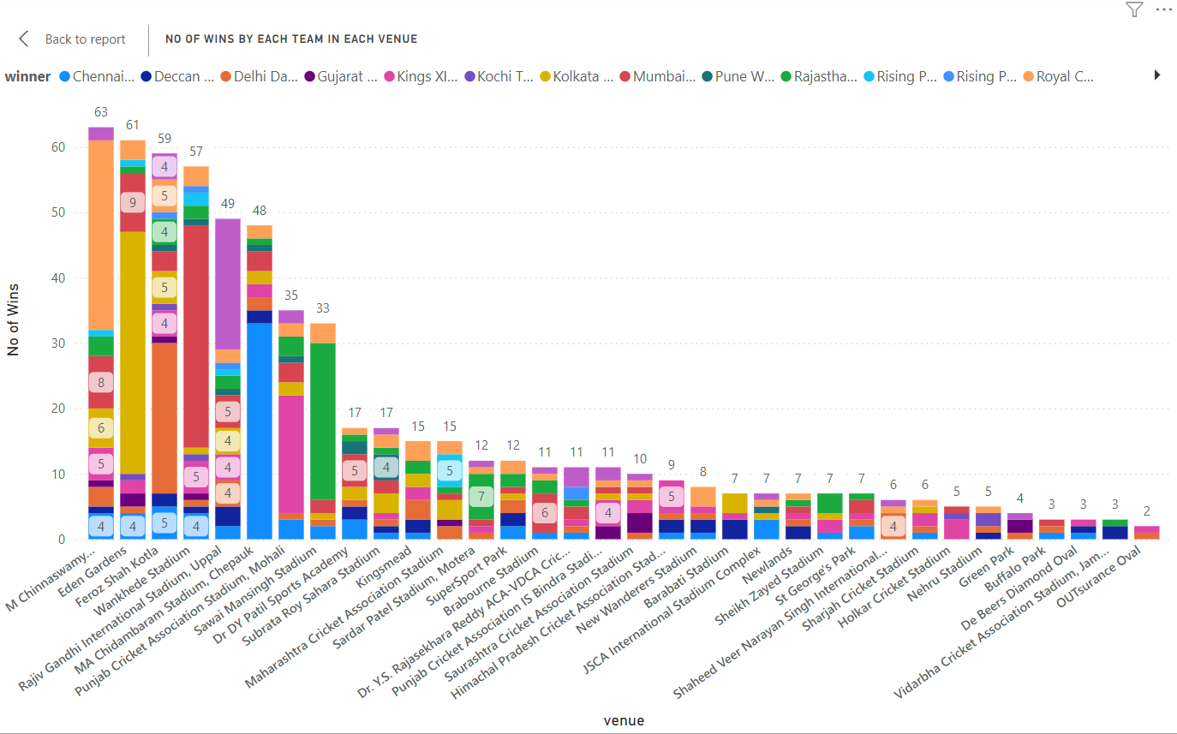

Slide 29
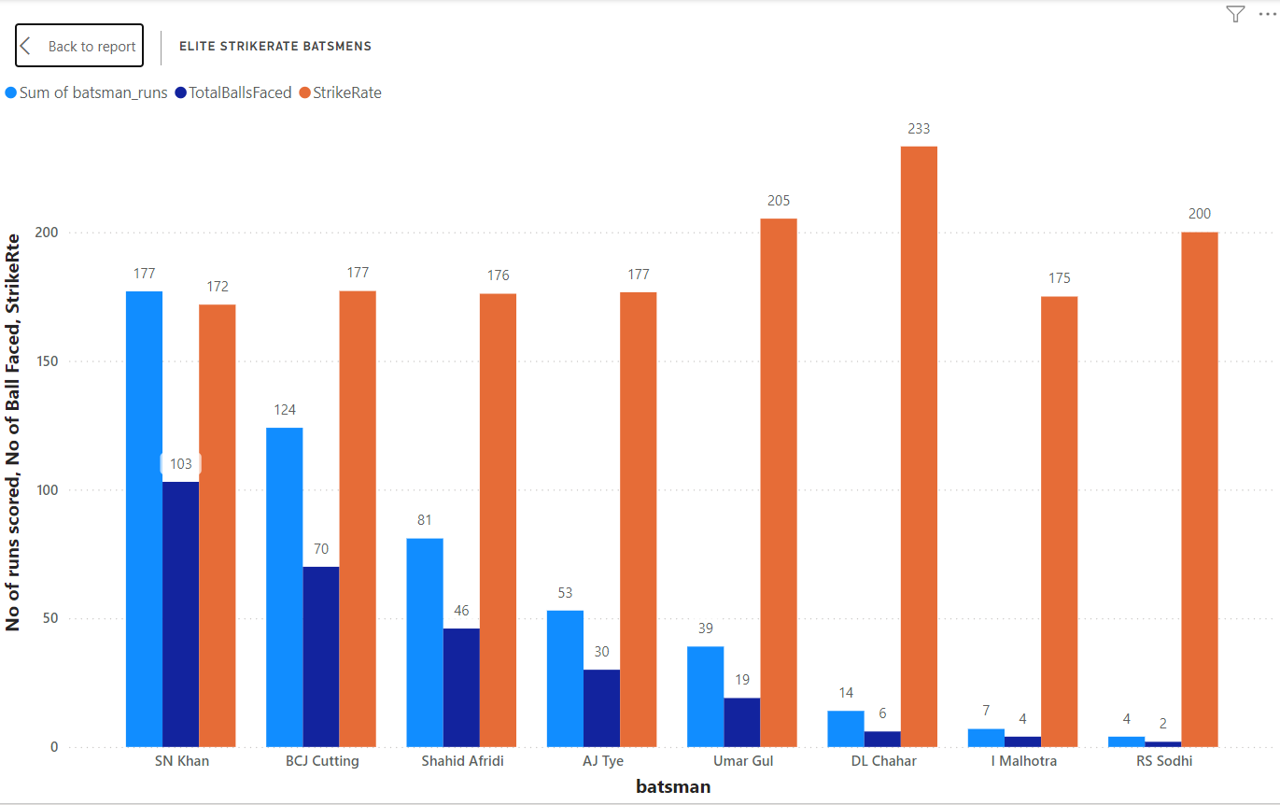
Batsman Analysis

Slide 30
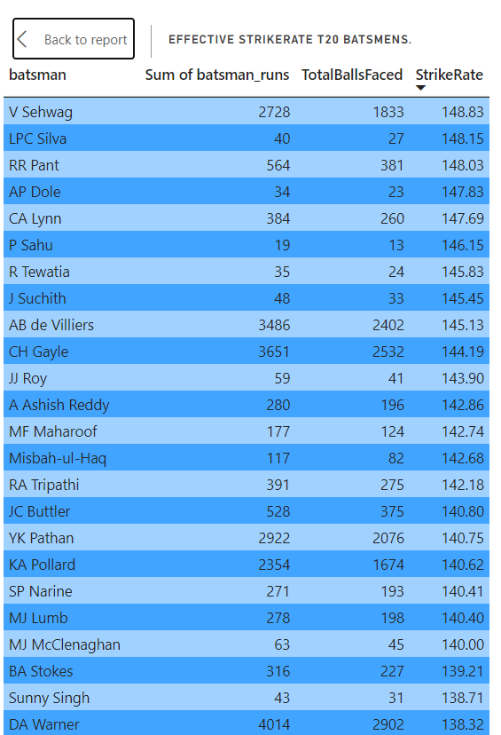

Slide 31
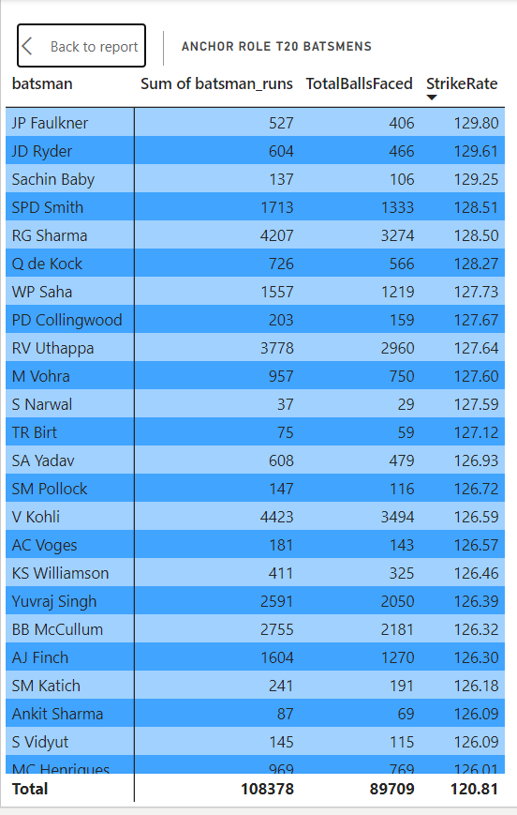

Slide 32
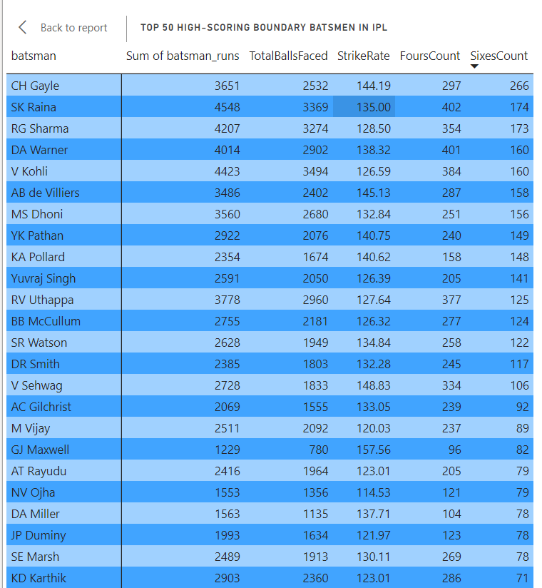

Slide 33
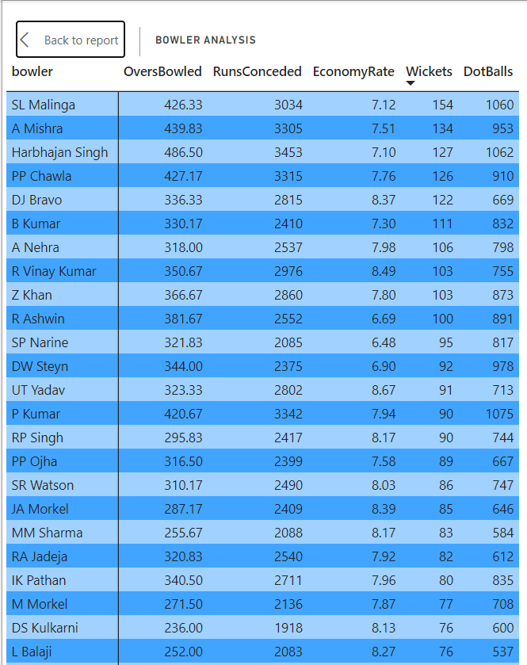
Bowler Analysis

Slide 34
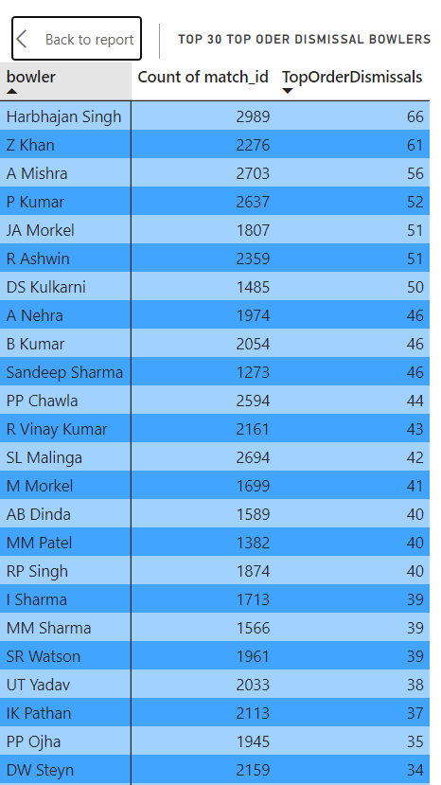

Slide 35
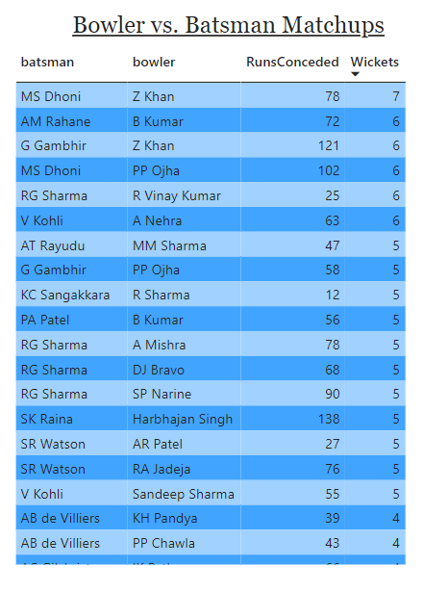

Slide 36
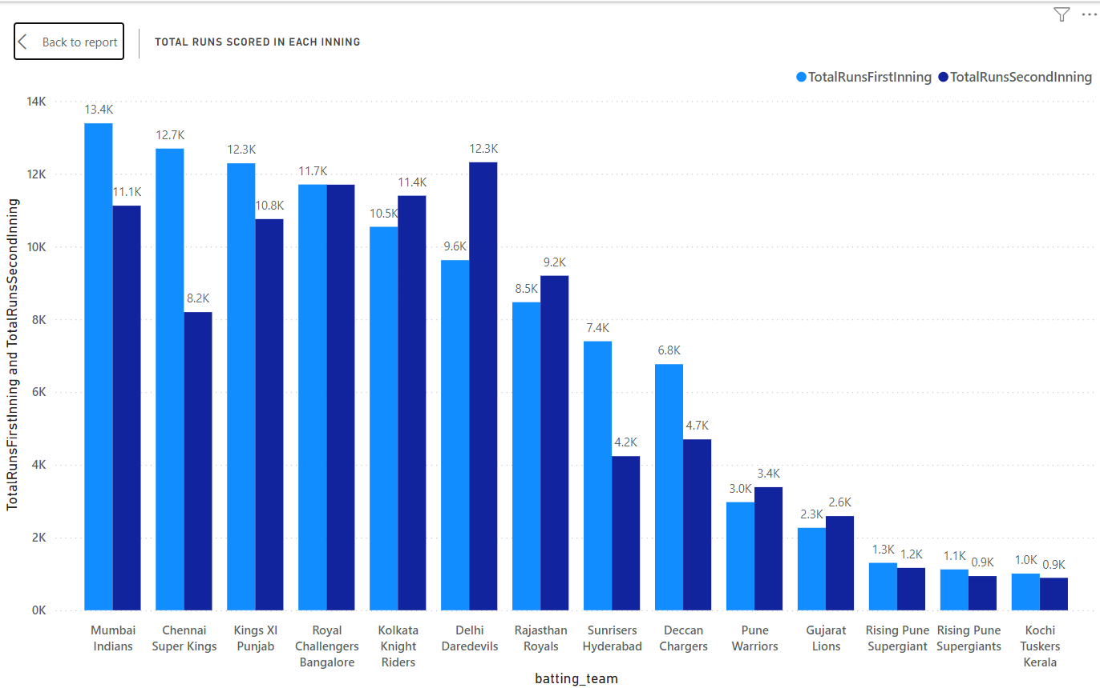
Innings Analysis

Slide 37
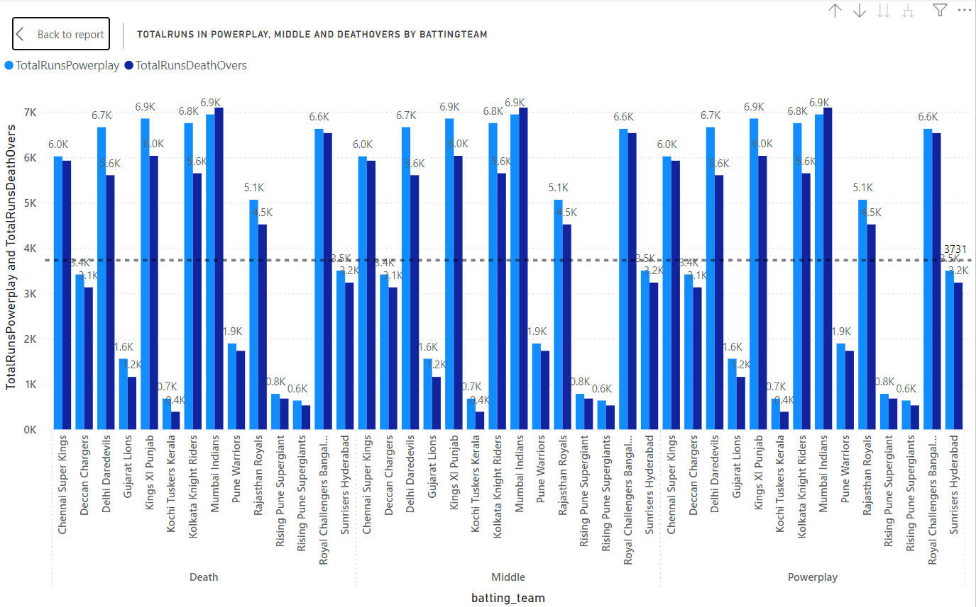
Clutch Analysis

Slide 38
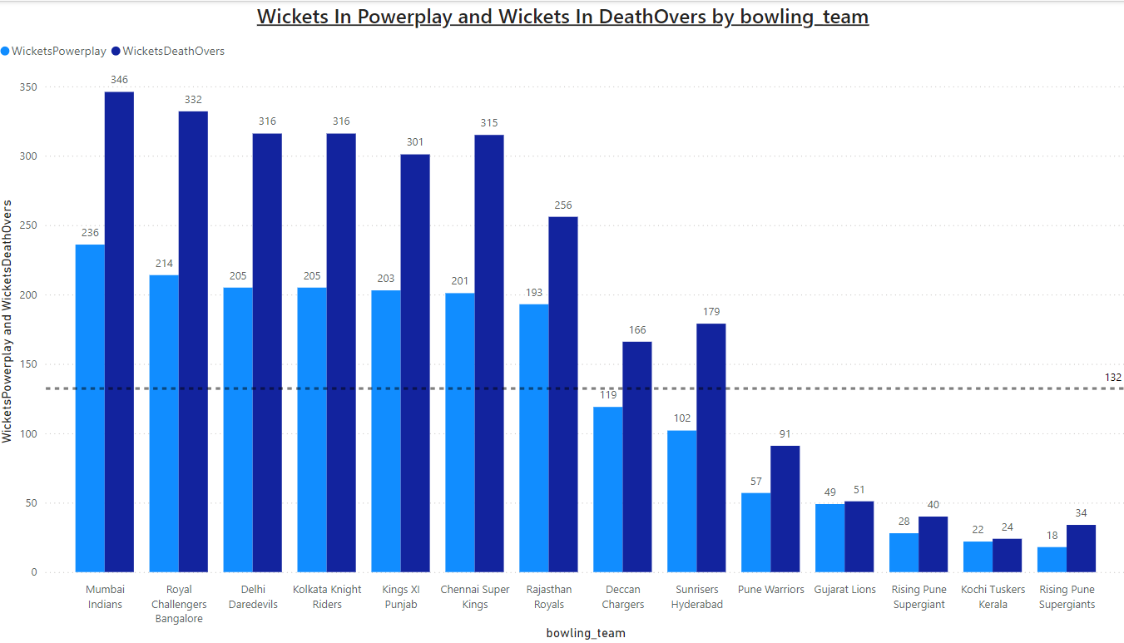

Slide 39
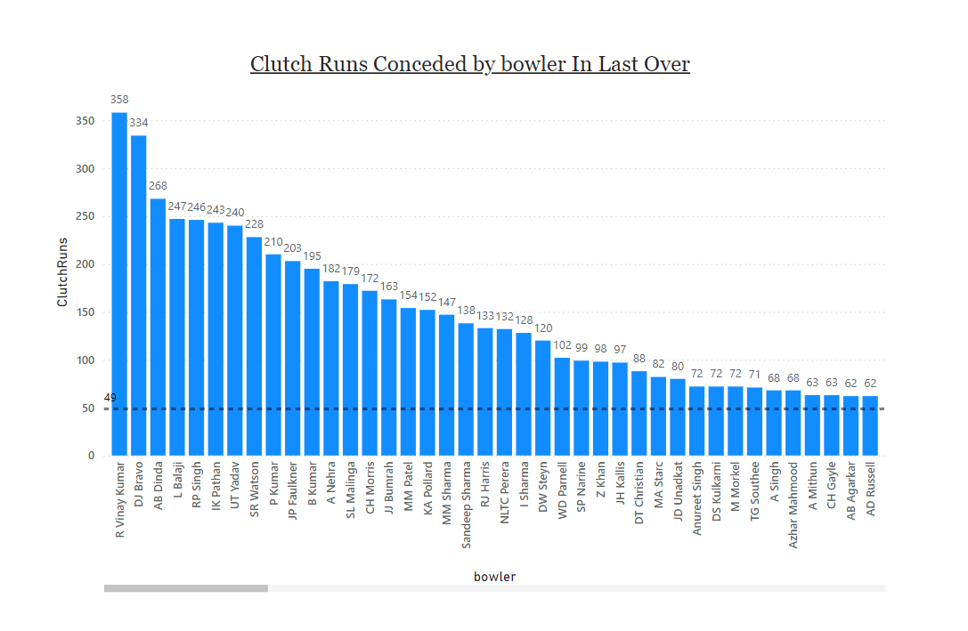

Slide 40
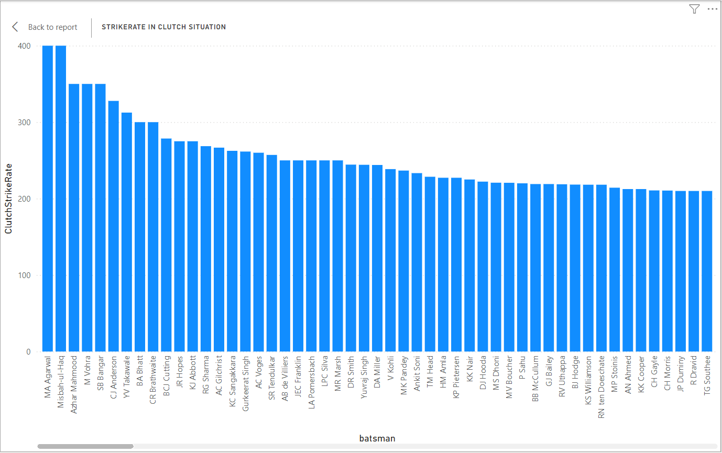

Slide 41
Extras Analysis

Slide 42
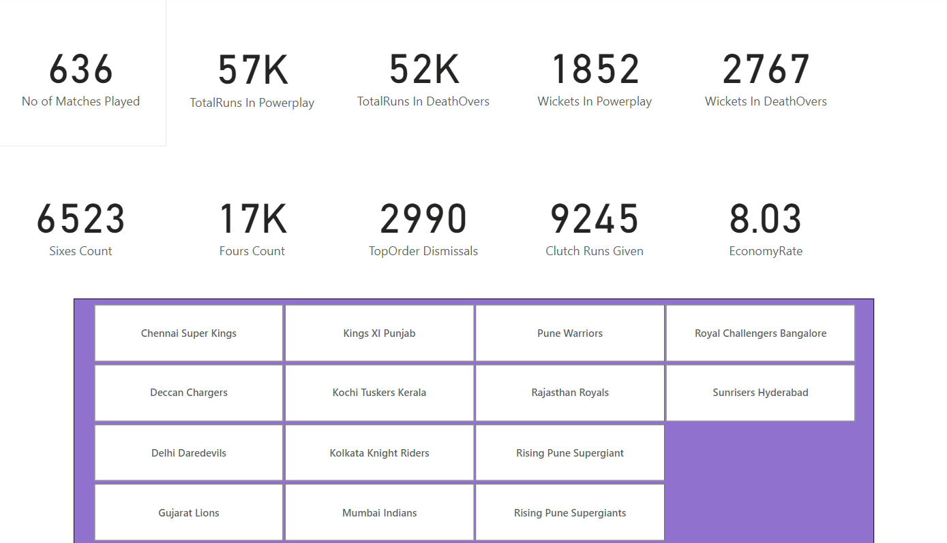
Card Analysis Dashboard

Slide 43
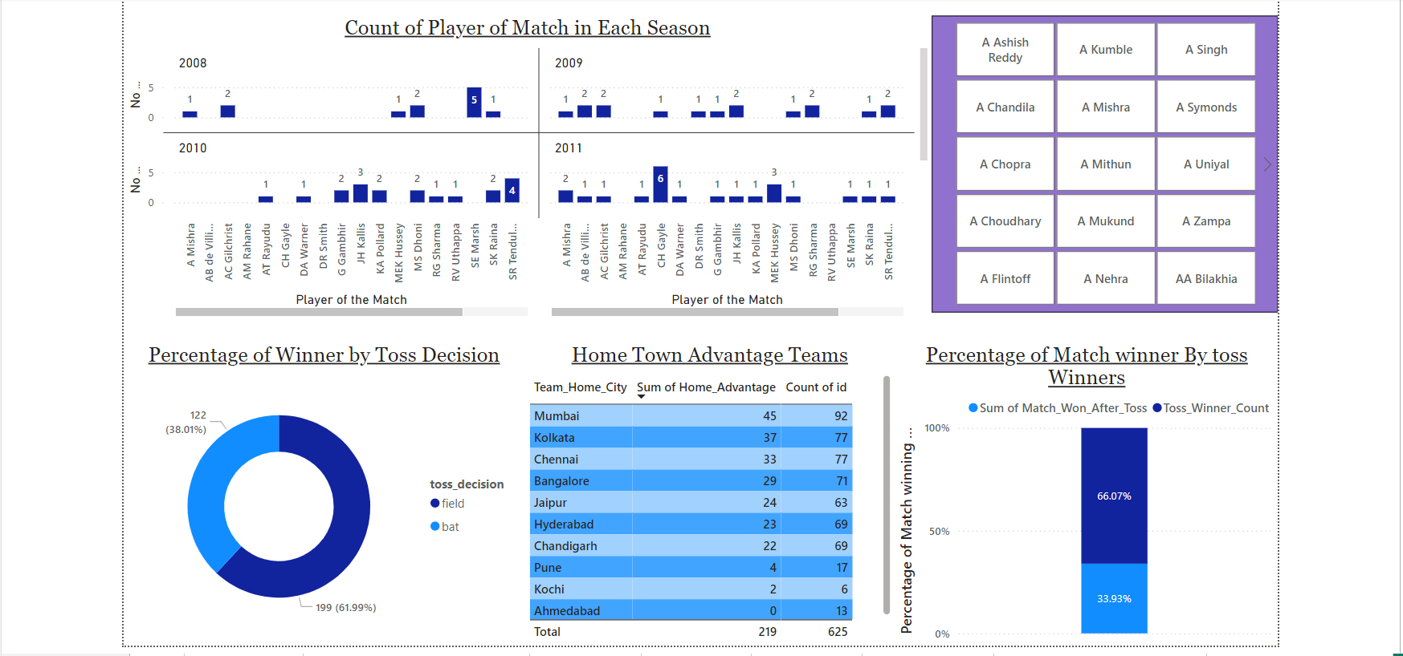
Dashboard-1

Slide 44
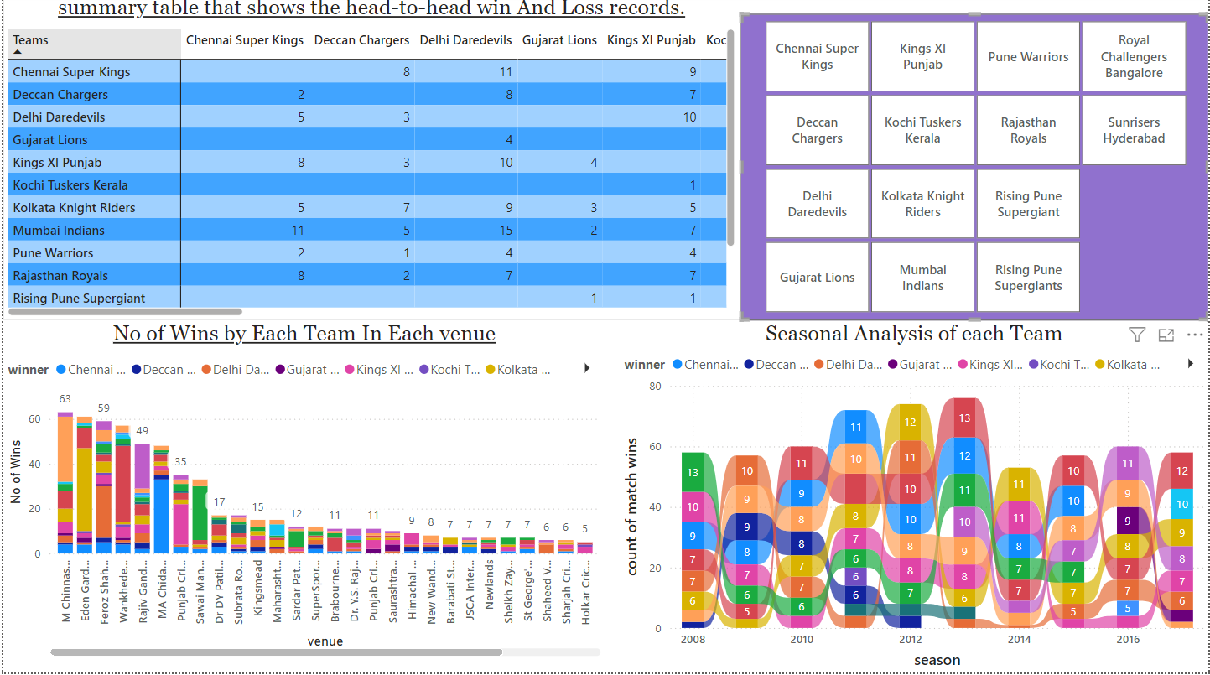
Dashboard-2

Slide 45
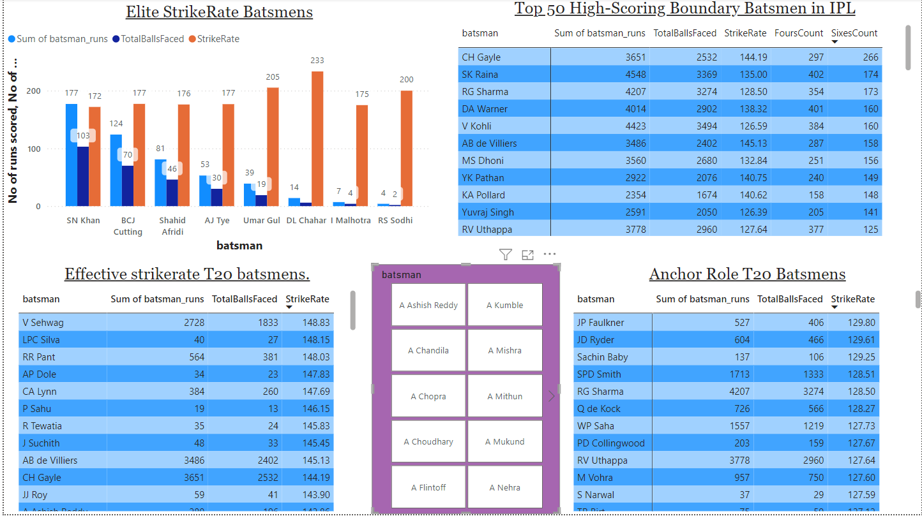
Batsman Analysis Dashboard

Slide 46
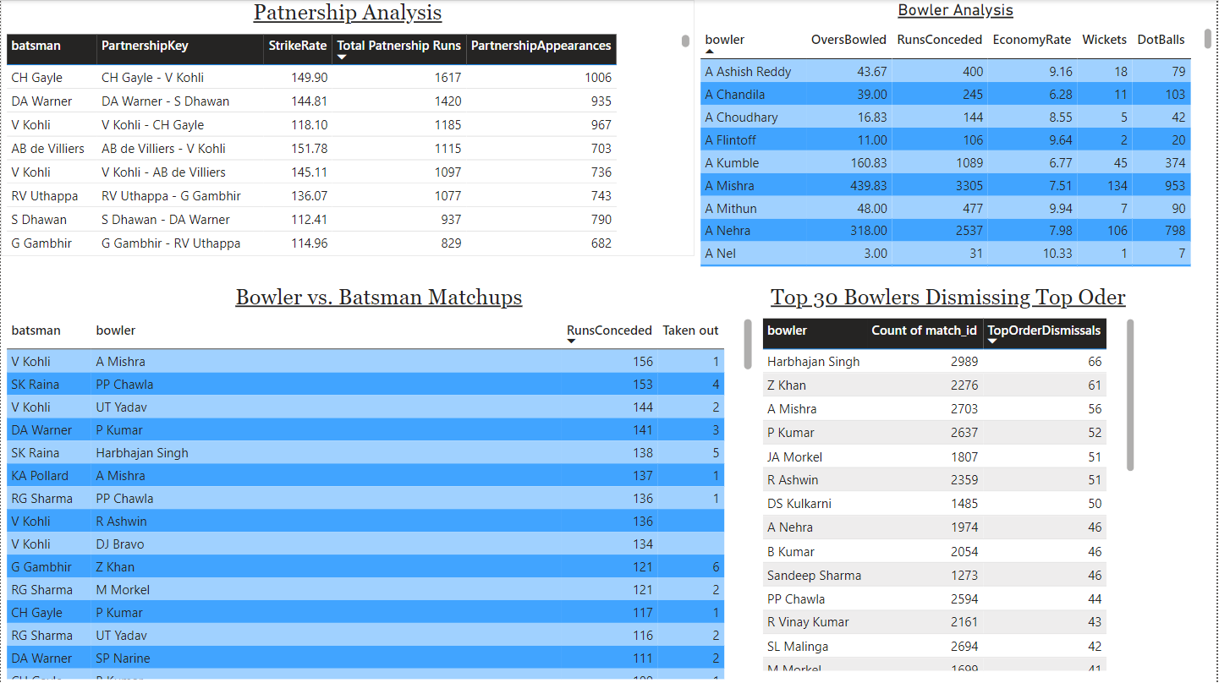
Bowler And Partnership Analysis Dashboard

Slide 47
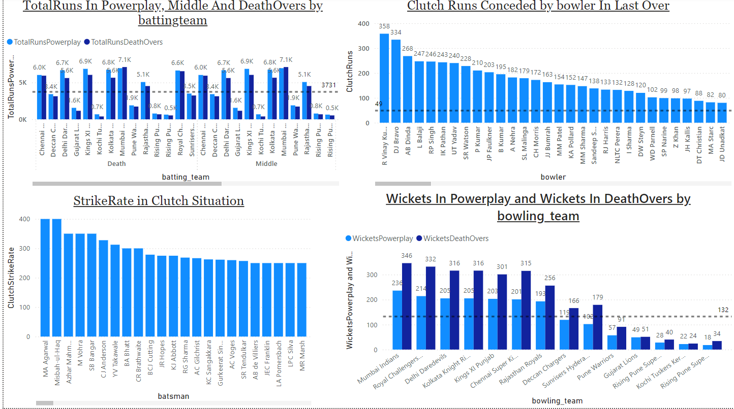
Clutch Analysis Dashboard

Slide 48
Thank You!!

